Slide 1


Artificial Intelligence
Ms. Swati Mali
Assistant Professor
Department of Computer Engineering
K. J. Somaiya College of Engineering
Somaiya Vidyavihar University

Slide 2
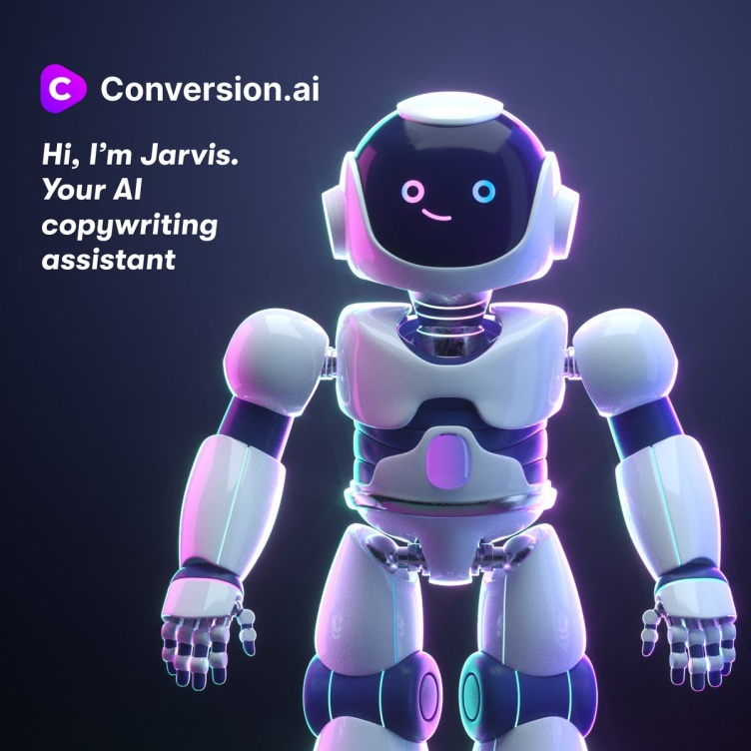
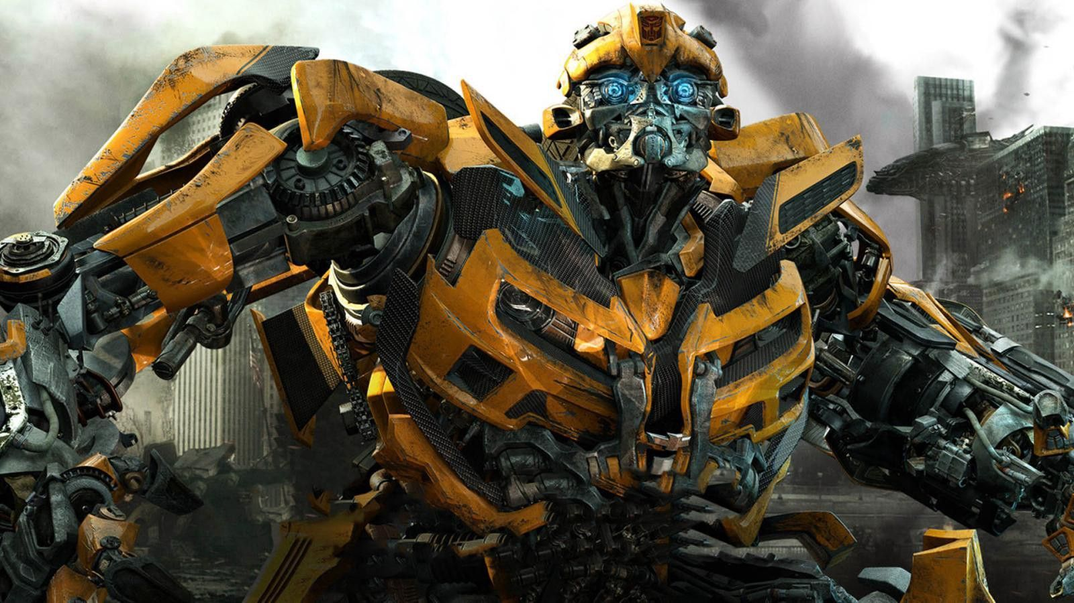
Where have you seen AI before?

Slide 3
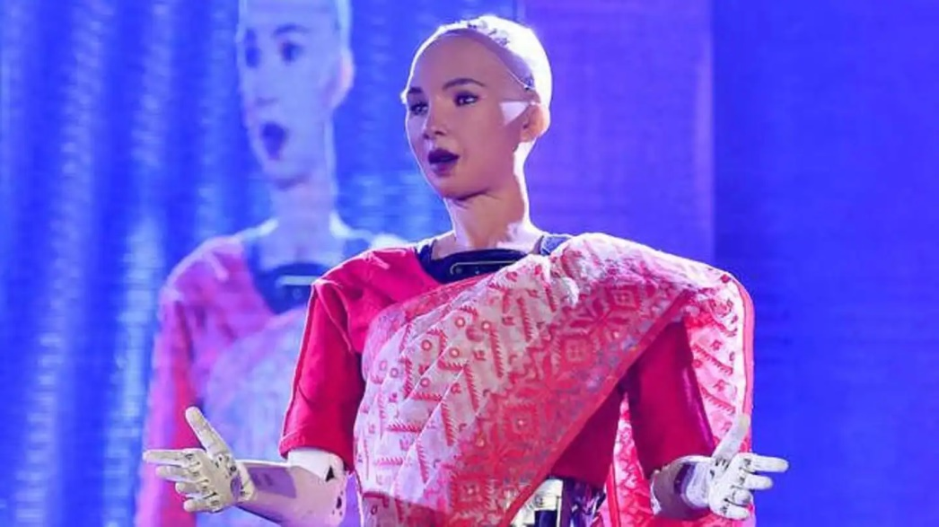
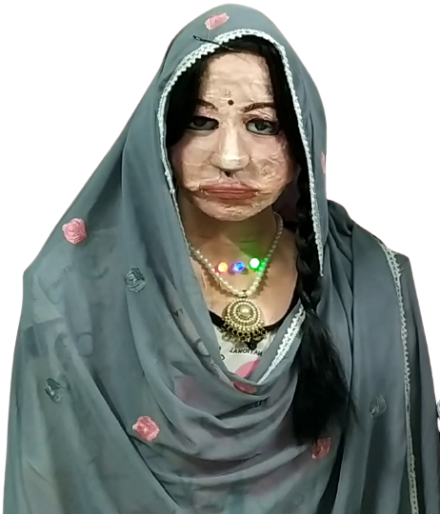
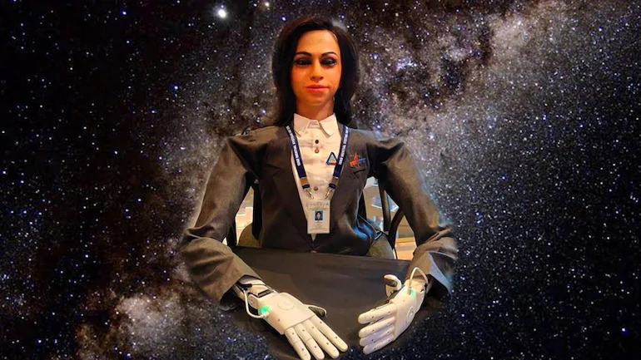
Where have you seen AI before?

Slide 4
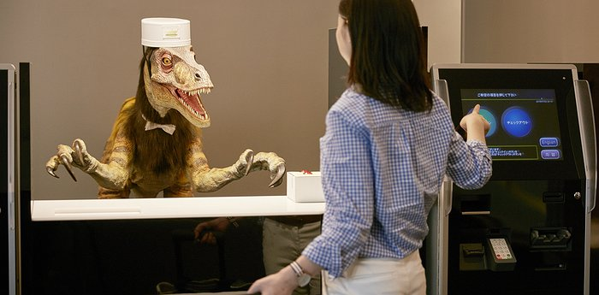
Where have you seen AI before?

Slide 5
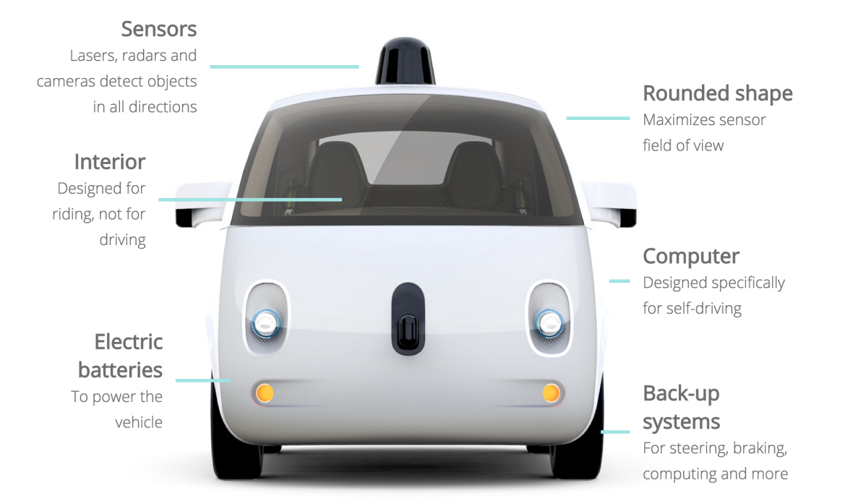
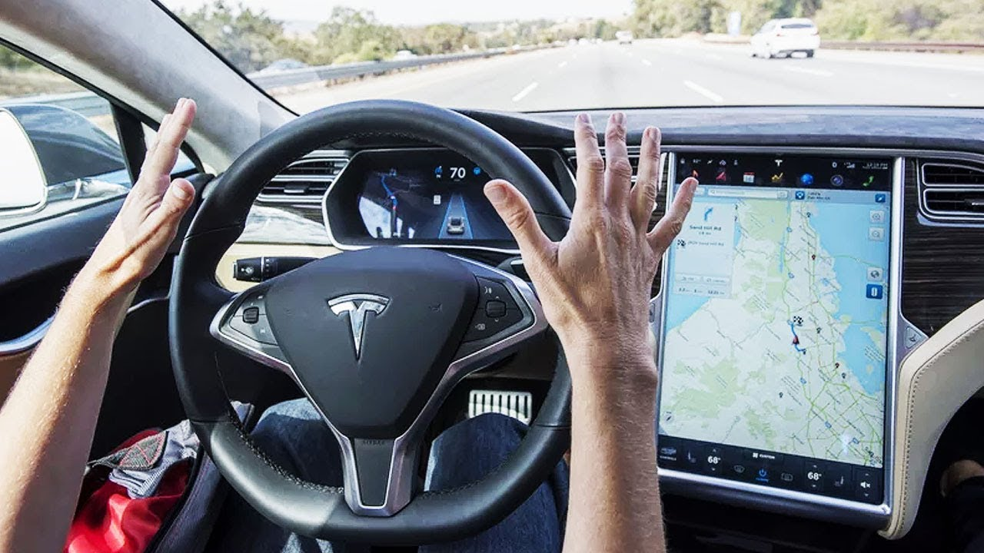
Where have you seen AI before?

Slide 6


Where have you seen AI before?

Slide 7

AI– Toy problems, games
Intelligent agents
Algorithms- searching
Knowledge representation & reasoning
Learning
Planning
Expert systems

Slide 8

Brain simulation
Cognitive architectures
Games
Knowledge and reasoning
Motion and manipulation
Natural language processing
Planning

Slide 9

Planning
Knowledge Engineering
Information retrieval
Game Theory
Expert systems
Natural language processing
Mathematics
Automation

Slide 10

Introduction to Artificial Intelligence
Intelligent Agents
Problem solving
Knowledge and Reasoning
Planning and Learning
Applications: Natural Language Processing(NLP), Expert Systems.

Slide 11
Study of AI projects
Implementation of family tree PROLOG program using condition-action rules based agent
Implementation of PROLOG program to solve a Crime mystery using Goal based agent architecture
Implementation of Medical Diagnosis in PROLOG
Implementation of uninformed search algorithms – BFS,DFS, DLS for the given problem
Implementation of informed search algorithm(Greedy Best First search/A*)
Implementation of alpha-beta pruning
Implementation of Constraint Satisfaction Problem
Implementation of learning algorithm
Virtual Labs experiment

Slide 12

Open book, open to internet test
Report on Expert systems
Closed book test on knowledge engineering

Slide 13

PROLOG
PROgramming in LOGic
JAVA
LISP
LISt Processing

Slide 14
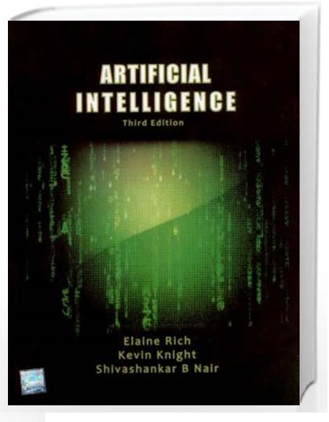
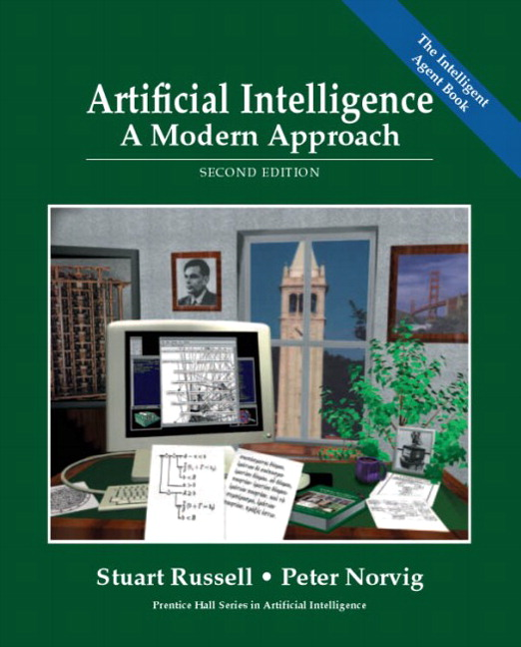
Stuart Russell and Peter Norvig, “Artificial Intelligence: A Modern Approach” Second Edition, Pearson Publication.
Allen Rich and Kelvin Knight, “ Artificial Intelligence” , third Edition, TMH

Slide 15
Think-pair-share
Flipped classroom

Slide 16
Limitations of AI
HIGH COST OF IMPLEMENTATION
CAN’T REPLACE HUMANS
DOESN’T IMPROVE WITH EXPERIENCE
LACKS CREATIVITY

Slide 17
Issues with implementation
Access to Data
Bias
Computing Time
Cost
Adversarial Attacks
No Consensus on Safety, Ethics, and Privacy

Slide 18


Slide 19

Artificial Intelligence is the study of how to make computers do the things, which at the moment, people do better.

Slide 20

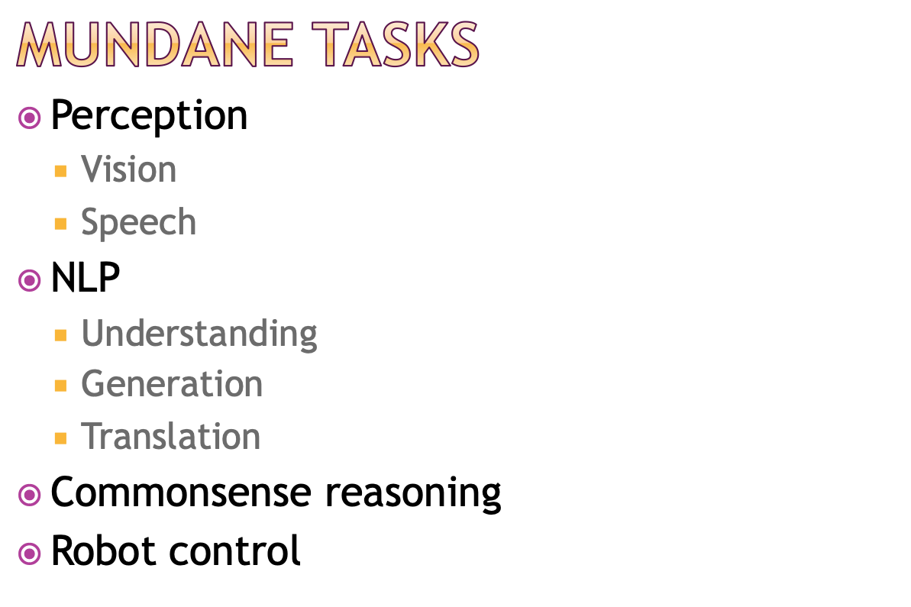

Slide 21
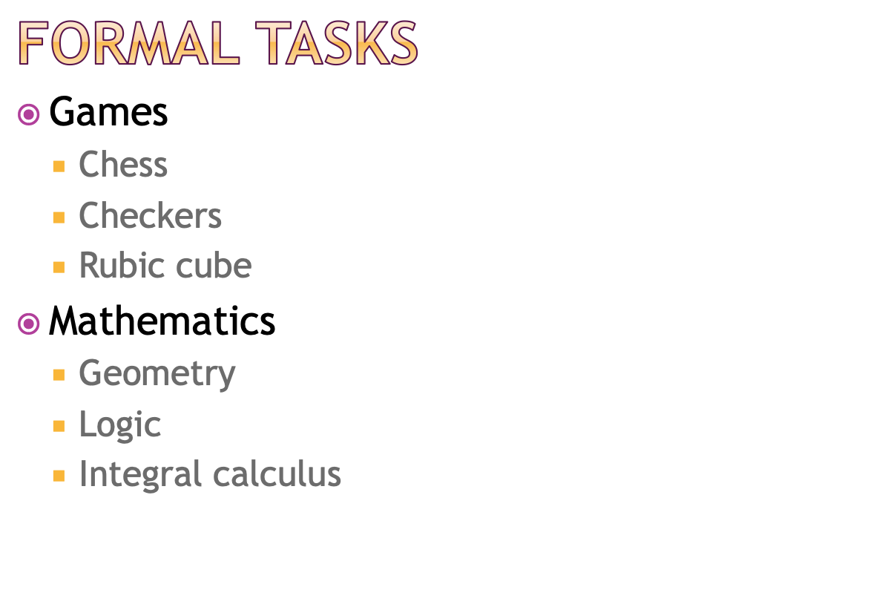

Slide 22
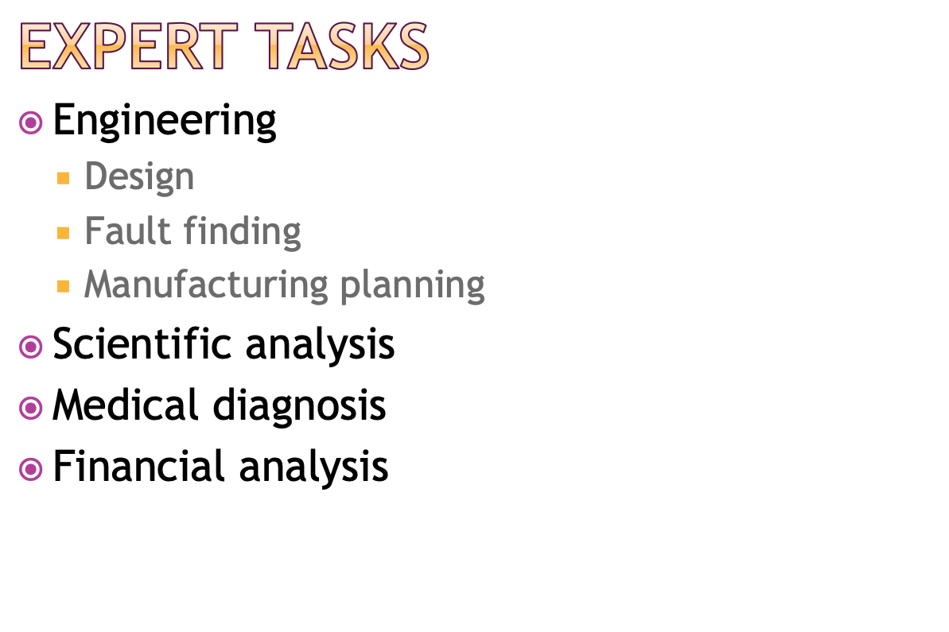

Slide 23

1. Systems that think like humans.
2. Systems that think rationally.
3. Systems that act like humans
4. Systems that act rationally

Slide 25
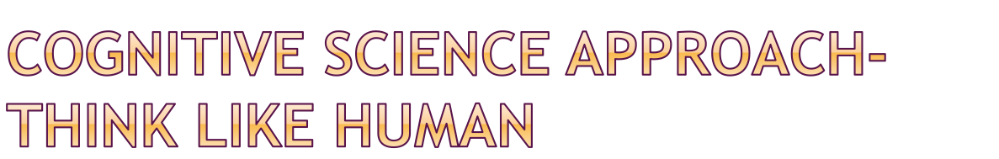
Automation of activities that we associate with human thinking
Two ways
Through introspection-trying to catch our own thoughts as they go by
Through psychological experiments
Argument: An algorithm performs well on a task and it is therefore a good model of human performance, or vice versa.

Slide 26

Study of enabling computers to do the things which require human intelligence.
The machine must have
natural language processing
knowledge representation
automated reasoning
machine learning
Total Turing Test
computer vision
robotics

Slide 27
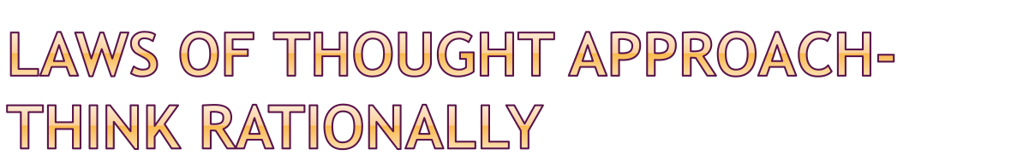
Proposed by Aristotle (384-322 B.C.)
Syllogisms provides patterns for argument structures that always yield correct conclusions when given correct premises
Emphasis is on correct inferences

Slide 28

Problems:
Its difficult to represent informal and uncertain knowledge in formal terms required by logical notation
There is a big difference between being able to solve a problem "in principle" and doing so in practice (few facts may exhaust all computational power)

Slide 29

Agent and Rational agent
Involves correct inferences as thinking rationally
Can suggest actions wherein no correct provably actions can be defined
Has ability to represent knowledge and reason with it to reach good decisions in a wide variety of situations
more general than the "laws of thought" approach
it is more amenable to scientific development than are approaches based on human behaviour or human thought

Slide 30

FIRST-ORDER Logic Language

Slide 31

Domains -optional
Predicates
Clauses
Facts
Rules
Goal

Slide 32
predicates
likes(symbol,symbol)
clauses
likes(ellen, reading).
likes(john, computers).
likes(john, badminton).
likes(leonard, badminton).
likes(eric, swimming).
likes(eric, reading).

Slide 33
domains
name, sport=symbol
predicates
likes(name, sport)
clauses
likes(ellen, tennis).
likes(john, football).
likes(tom, baseball).
likes(eric, swimming).
likes(mark, tennis).
likes(bill, Activity) if likes(tom, Activity).

Slide 34
rules
Difference between predicates and clauses
likes(person, sports)
likes(ram, tennis).
Capitalization and free variables
Clauses of same Predicates should be grouped together
No nesting of predicates
Father(dashrath,father(kush)).

Slide 35

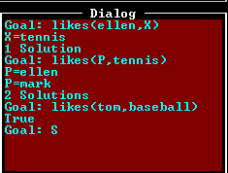

Slide 36
domains
product, sum = integer
predicates
add_em_up(sum, sum, sum)
multiply_em(product, product, product)
clauses
add_em_up(X, Y, Sum) :- Sum = X + Y.
multiply_em(X, Y, Product) :- Product = X * Y.

Slide 37


Slide 38
Rule base Vs knowledgebase programming (C/Java Vs Prolog/LISP)
 | Rule Based System | Knowledge Based System
Can Process | Data Rules | Data Rules Knowledge
Can Output | Information Decision | Information, Decision, Expert Advice, Recommendations
Commonly used for | Enterprise rules | Domain specific rules
Ideal for | Simplistic business rules | Complex business rules
Best for these types of applications | Decision Compliance | Advising, Product Selection, Recommending, Trubleshooting
Domain | Broad Logic | Deep Logic

Slide 39
Queries? Thank you!!

